Slide 1

MACHINE
INTELLIGENCE
Hidden Markov Model
K.S.Srinivas
Department of Computer Science and Engineering

Slide 2

MACHINE INTELLIGENCE
Discrete Markov Processes
K.S.Srinivas
Department of Computer Science and Engineering

Slide 3
MACHINE INTELLIGENCE
Discrete Markov Process
We have so far commonly dealt with random samples.
A random sample can be thought of as a set of objects that are chosen randomly. Or, more formally, it’s “a sequence of independent, identically distributed (IID) random variables“
Identically Distributed means that there are no overall trends–the distribution doesn’t fluctuate and all items in the sample are taken from the same probability distribution.
Independent means that the sample items are all independent events. In other words, they aren’t connected to each other in any way.

Slide 4
MACHINE INTELLIGENCE
Discrete Markov Process
Random variables X and Y on the same probability space are said to be independent if the events X = a and Y = b are independent for all values a,b. Equivalently, the joint
distribution of independent r.v.’s decomposes as
P(X = a,Y = b) = P(X = a)P(Y = b) ∀a,b.
Examples: Put m balls with numbers written on them in an urn. Draw n balls from the urn with replacement, and let Xi be the number on the ith ball. Then X1, X2, ..., Xn will be i.i.d.
But if we draw the balls without replacement, X1, X2, ..., Xn will not be i.i.d. - they will all have the same distribution, but will not be independent.
If we draw the balls with replacement, but let Xi be i times the number on the ith ball, then X1, X2, ..., Xn will not be i.i.d. - they will be independent, but they will have different distributions.

Slide 5
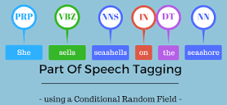
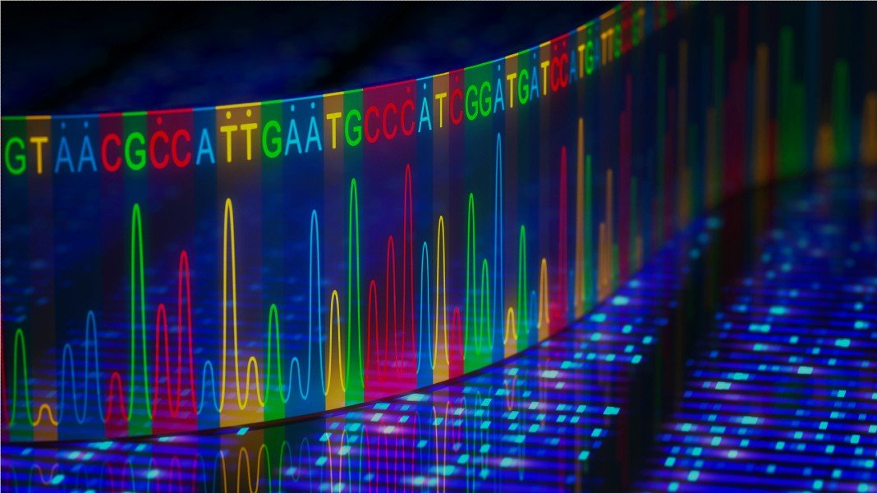
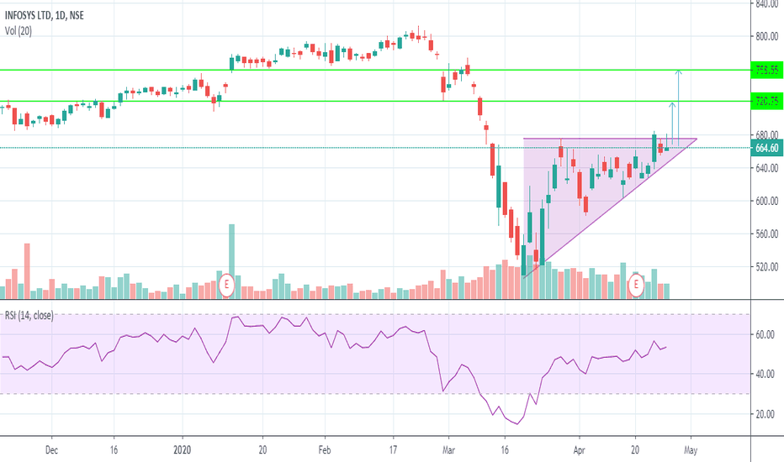

MACHINE INTELLIGENCE
Discrete Markov Process
The IID assumption that we make during Naïve Bayes is a very strong assumption
This does not always hold good in many cases

Slide 6
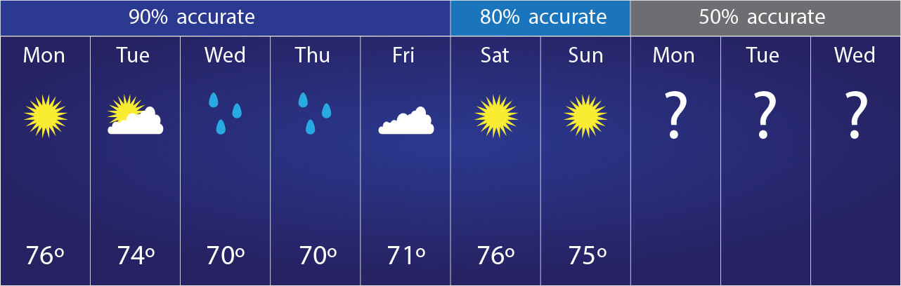
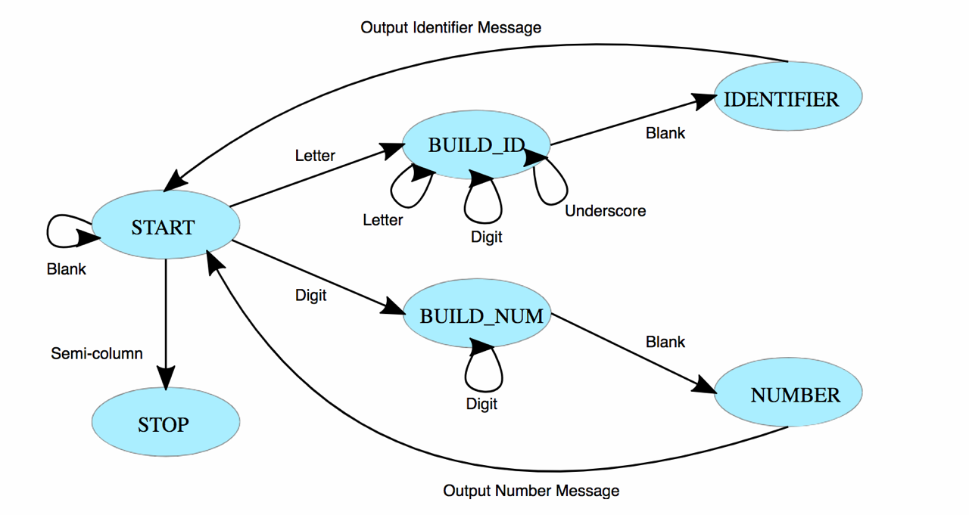
MACHINE INTELLIGENCE
Discrete Markov Process
In each of these cases that we just saw the occurrence of a value of a feature effects that value of another feature
As an example if it had rainy over the last 48 hours what are the chances of today being rainy as opposed to be sunny.
In each of these cases we need to consider the probabilities effect of one feature on another.
Modelling of such cases is done on the lines of Finite State Machines

Slide 7

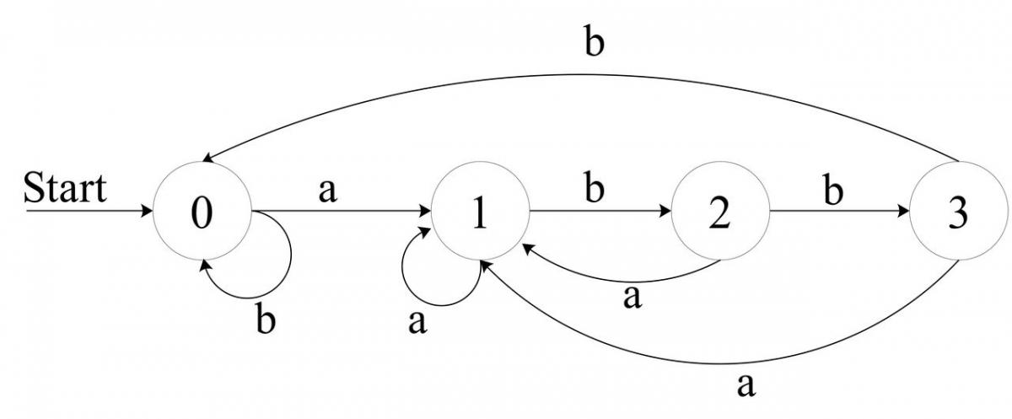
MACHINE INTELLIGENCE
Discrete Markov Process
We know that state machines usually have a start end state, an alphabet that takes you to a new state and we have an end state.
The alphabets can be thought of the change in conditions that cause a state transition.
We modify the conditions slightly in modelling Markov Process there is no THE start state
Transitions can happen between all states ( more on this later)

Slide 8
MACHINE INTELLIGENCE
Discrete Markov Process
Random variables
The possible states of the outcomes are also known as the domain of the random variable, and the outcome is based on the probability distribution defined over the domain of the random variable.
In rolling a six sided die, the domain of the random variable outcome, O, is given by domain(O) = (1, 2, 3, 4, 5, 6), and the probability distribution is given by a uniform distribution P(o) = 1/6 ∀ ∈ domain(O).
The domain of the random variable has discrete variables; such random variables are known as discrete random variables.
Consider the random variable representing the stock price of Google tomorrow. The domain of this random variable will be all positive real numbers with most of the probability mass distributed around ±5% of today's price. Such random variables are known as continuous random variables.

Slide 9
MACHINE INTELLIGENCE
Discrete Markov Process
Random processes
Random variables are able to mathematically represent the outcomes of a single random phenomenon.
What if we want to represent these random events over some period of time or the length of an experiment?
let's say we want to represent the stock prices for a whole day at intervals of every one hour
we want to represent the height of a ball at intervals of every one second after being dropped from some height in a vacuum.
For such situations, we would need a set of random variables, each of which will represent the outcome at the given instance of time. These sets of random variables that represent random variables over a period of time are also known as random processes. It is worth noting that the domains of all these random variables are the same.

Slide 10
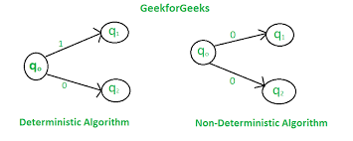
MACHINE INTELLIGENCE
Discrete Markov Process
Such random processes, in which we can deterministically find the state of each random variable given the initial conditions (in this case, dropping the ball, zero initial velocity) and the parameters of the system (in this case, the value of gravity), are known as deterministic random processes (commonly called deterministic processes).
Random processes, in which we can't determine the state of a process, even if we are given the initial conditions and all the parameters of the system, are known as stochastic random processes (commonly called stochastic processes).

Slide 11
MACHINE INTELLIGENCE
Discrete Markov Process
Markov processes
A stochastic process is called a Markov process if the state of the random variable at the next instance of time depends only on the outcome of the random variable at the current time.
Markov property
This property of a system, such that the future states of the system depend only on the current state of the system, is also known as the Markov property.
Systems satisfying the Markov property are also known as memoryless systems

Slide 12
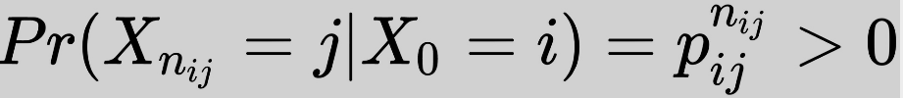
MACHINE INTELLIGENCE
Discrete Markov Process
A Discrete Markov process ( Markov chain)
The start state is not defined
Is a stochastic process over a discrete state space satisfying the Markov property.
The probability of moving from the current state to the next state depends only on the present state and not on any of the previous states.
Is is said to be irreducible if we can reach any state of the given Markov chain from any other state.
state j is said to be accessible from state i if an integer nij ≥ 0 exists such that the following condition is met:

Slide 13
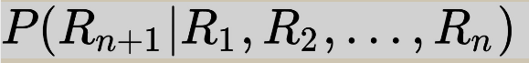
MACHINE INTELLIGENCE
Discrete Markov Process
This is the probability of a system being in state Rn+1 given that the machine has been in R1 at t=1, R2 at t=2 and Rn at t=n can be represented as follows
Such a process is called as a ‘n’ order Markov Process where the machine being in a state at n+1 is conditioned by all the previous states leading up to n.
Generally Markov property is applies in which the above expressed is reduced to

Slide 14
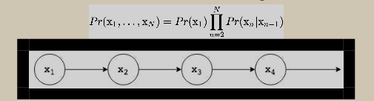
MACHINE INTELLIGENCE
Discrete Markov Process
A graphical representation of a first order Markov Chain with conditional dependence on only the previous state can be represented as
This is how probabilistic graphical models are generally represented,
Nodes represent random variables
Edges represent a conditional probability distribution between these two variables.
This graphical representation gives us insight into the causal relationships between random variables.

Slide 15
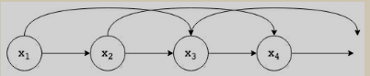
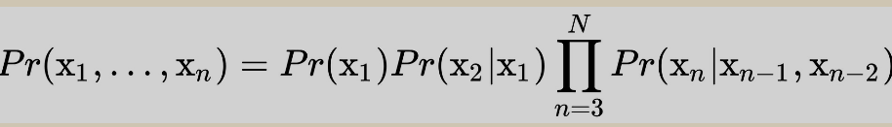
MACHINE INTELLIGENCE
Discrete Markov Processes
As an example this is a 2nd order Markov Process
Where the conditional probability is represented as follows

Slide 16
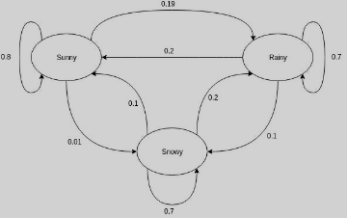
MACHINE INTELLIGENCE
Discrete Markov Processes
Let us represent this with an example of the weather being sunny rainy or cloudy only thru a first order Markov chain

Slide 17
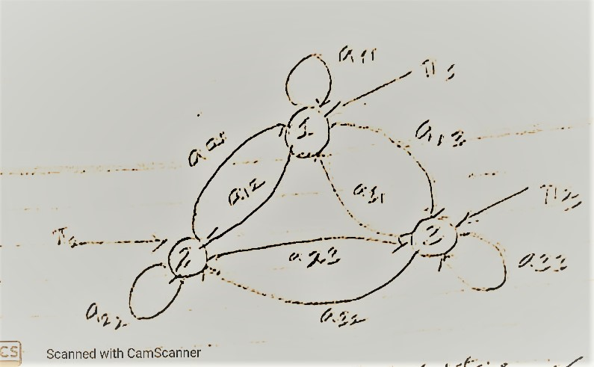
MACHINE INTELLIGENCE
Discrete Markov Process
Lets understand the model a little better and introduce some more terms that we need for the model that we will apply.
The π that you see here are the starting probabilities since we can start from any state to any other state
a12 states the tranisition probability of moving from state 1 to state 2
Σ of all a’s from a state must add upto to one.

Slide 18
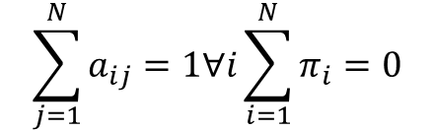
MACHINE INTELLIGENCE
Discrete Markov Process
The π that you see here are the starting probabilities since we can start from any state to any other state
All of the transition probabilities can be represented as a matrix called as the transition matrix
A = | a11 a12 a13 |
| a21 a22 a23 |
| a31 a32 a33 |
A11 represents the probability of moving from a1 to a1.
We can now fully define our model
Λ (Π, A) for a discrete Markov process
$$\sum_{j=1}^{N}{a_{ij}}=1∀ⅈ\sum_{i=1}^{N}{π_{i}}=0$$

Slide 19
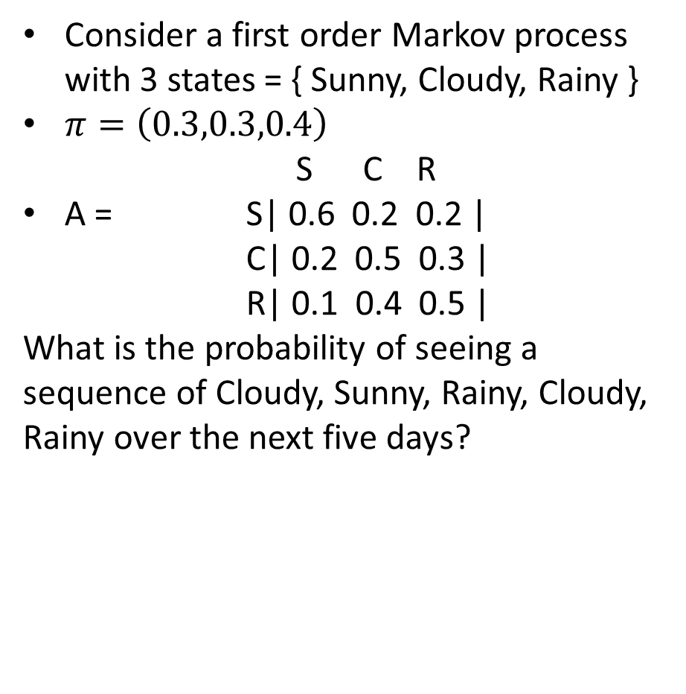
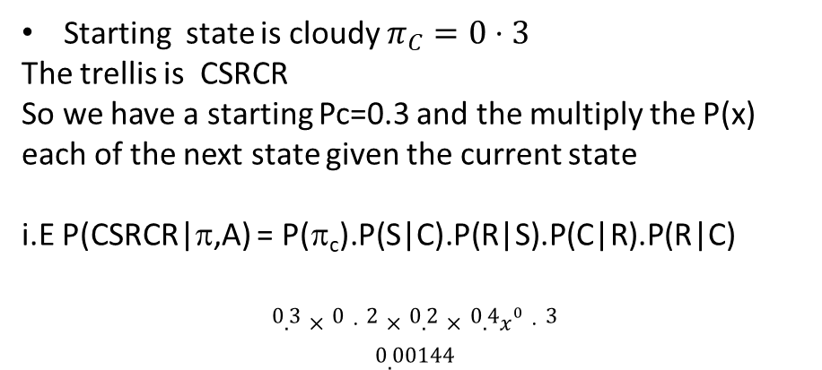
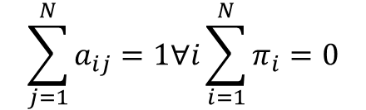
MACHINE INTELLIGENCE
Example Problem (1)
Consider a first order Markov process with 3 states = { Sunny, Cloudy, Rainy }
$π=\left(0.3,0.3,0.4\right)$
S C R
A = S| 0.6 0.2 0.2 |
C| 0.2 0.5 0.3 |
R| 0.1 0.4 0.5 |
What is the probability of seeing a sequence of Cloudy, Sunny, Rainy, Cloudy, Rainy over the next five days?
$$\sum_{j=1}^{N}{a_{ij}}=1∀ⅈ\sum_{i=1}^{N}{π_{i}}=0$$
Starting state is cloudy $π_{C}=0⋅3$
The trellis is CSRCR
So we have a starting Pc=0.3 and the multiply the P(x) each of the next state given the current state
i.E P(CSRCR|π,A) = P(π_{c}).P(S|C).P(R|S).P(C|R).P(R|C)
$$\begin{matrix}0.3×0⋅2×0.2×0.4x^{0}⋅3 \\ 0.00144\end{matrix}$$

Slide 20
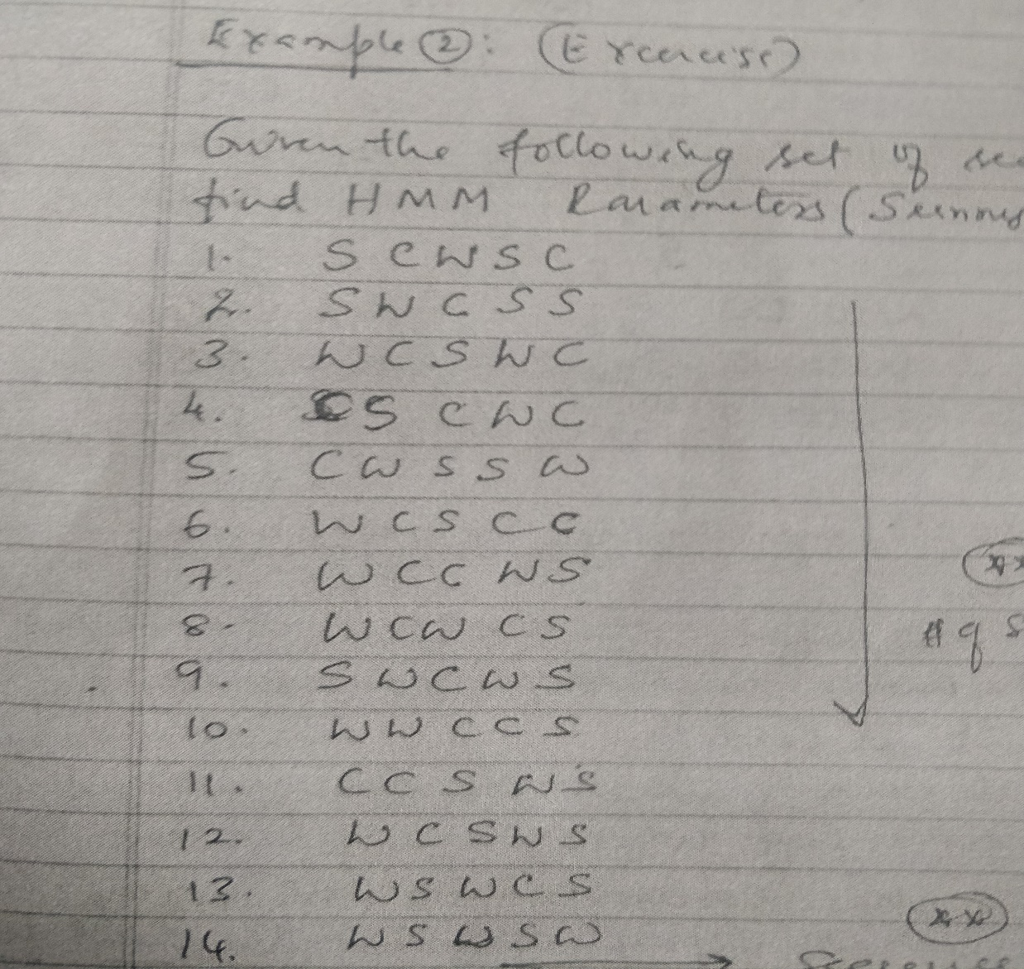
MACHINE INTELLIGENCE
Example Problem (2)
Consider the trellis over a 14 day period
Compute the parameters of the Discrete Markov Model
i.ecompute
And the transition matrix
Solution:

Slide 21
MACHINE INTELLIGENCE
Example Problem (2)
Consider the trellis over a 14 day period
Compute the transition matrix

Slide 22
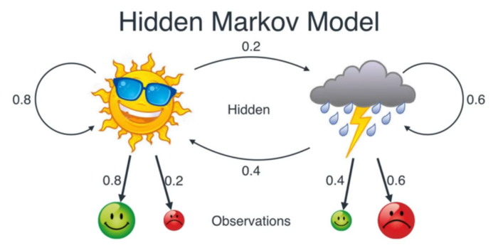
MACHINE INTELLIGENCE
Hidden State
Consider the following problem. We have 2 friends Karan and Vijay one in Bangalore and the other in Shimoga
They speak to each other every day
The only thing Karan states to Vijay on any day is whether is happy or Angry.
His anger or happiness is defined by the weather it being sunny or rainy
Given that he says he is HHSHS can you guess the weather in Shimoga
We have another probability called the emission probability
i.E given a state – weather what is probability of being happy or sad
This is represented by another matrix called the emission matrix. See you in the next class

Slide 23
THANK YOU
K.S.Srinivas
srinivasks@pes.edu
+91 80 2672 1983 Extn 701

